Slide 1
Program Committee
Chair Briefing

Slide 2
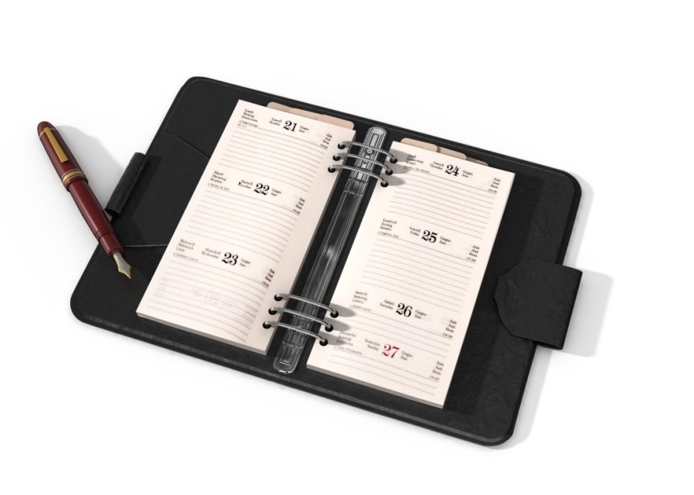
Agenda
Conference Program
Housekeeping Items and Deadlines
Action and Information Items
Evaluation of PLN

Slide 3
Conference Highlights Monday, August 19th
1:30 Urban Task Force Pre-Conference Tour
3:30 PLC Meeting with Committee Chairs and Vice-Chairs
5:00 Newcomer Orientation

Slide 4
Conference Highlights Tuesday, August 20th
Opening Session
Amy Lynch
Round Table Discussions
Break-out Sessions
10:30 – noon
1:30 – 3:00
Please
Your committee’s computer & projector needed

Slide 5
Time with Administrative Advisors
Tuesday 3:30 – 5:00
Wednesday 1:30 – 5:00

Slide 6
Housekeeping Items: State Reports: Optional
Committee’s Choice

Slide 7
Housekeeping Items: Update 2012 Plan of Work
Can be completed pre-conference!
Due Thursday, August 22nd
Select Committees tab
Select your committee
Select “Update Plan of Work”
Make changes
This is now your accomplishment report
E-mail updates to plnconference@gmail.com
http://srpln.msstate.edu/

Slide 8
Housekeeping Items: Create New Plan of Work
Due Thursday, August 22nd
Template posted on PLN site
Include NEW officers & representatives
Include conference call schedule
E-mail Plan of Work to plnconference@gmail.com

Slide 9
Housekeeping Items: Elect Officers & PLC Representatives
Report new officers on 2013-2014 Plan of Work
1862/1890 PLC Representatives: 3 years
Officers: 1 year, but can move up chain
New 1890/1862 PLC Reps. accompany current Reps. to PLC meeting Thursday, August 22, 6:45 a.m.

Slide 10
PLC Representatives Completing Terms
COM: Ayanna McPhail (1890)*
CRD: Joy Moten-Thomas (1890)
FCS: Anne Sorter (1862)
4H: Dorothy Wilson (1890)
IT: Lalit Rainey (1890)**
ASRED: Ed Jones*
*Served a partial term, so can be reappointed
**Reappoint to fulfill duties of PLN Chair

Slide 11
Executive Committee
ASRED Ed Jones
ANR/FCS/CRD/4H Chris Boleman

Slide 12
Housekeeping Items: Update Members’ List & Listserv
Due Thursday, August 22nd
Hard copy of current list provided
Pass list around in committee meeting
Listserv: Primary email address (no aliases)
Return updated list to registration desk
Send updates throughout the year to:
Rachel Welborn
rachelw@srdc.msstate.edu

Slide 13
Housekeeping Items: Action & Information Items
Due Wednesday, August 21, by 3:00 p.m.
Template for Action & Information Items
E-mail to plnconference@gmail.com

Slide 14
Action Item
A proposed
activity or policy decision
needing
joint
AEA and ASRED
administrator approval.
Clear & Concise Proposal that:
Requires a commitment of resources across 1862 and 1890 institutions
Changes established practice
Impacts others outside of the committee
OR

Slide 15
Action Item: Good Example
Health Disparities: Family and Consumer Sciences
Background: A regional meeting of FCS Program Leaders & Specialists is needed to:
1) Provide professional development in the area of health disparities;
2) Explore opportunities for multi-state and interdisciplinary efforts;
3) Form teams to write proposals for funding, development or adoption of health curricula across the region.
Action Requested: Approval for regional meeting
Timeline: September 1, 2013 - August 31, 2014
Commits resources
Concise
Committee cannot move forward w/o approval

Slide 16
Action Item: Poor Example
Verbose & meanders
Encourage Participation in National Meetings:
Background – Due to the impending success of the national eXtension effort, faculty of state Extension organizations have more opportunities to collaborate with colleagues on a broader scale. Participation in national meetings would give faculty more opportunities to network with their counterparts and learn of ongoing activities in which they can partner. Extension leadership is asked to consider supporting the increase in attendance by faculty to national meetings that could improve relationships and collaboration between state organizations.
Committee(s) Involved – All committees
Action Needed – Approval for professional faculty/staff
to attend national meetings.
Timeline – 2013 and beyond.
Approval of travel decision of each administrator, not joint group
Vague

Slide 17
Information Item
Requires
no action
from
AEA &
ASRED
Conveys concise information
relevant to both AEA & ASRED on:
Current issues
Proposed activities
Work conducted
OR

Slide 18
Information Item: Good Example
Guidelines for Charges, Royalties, Permissions & Sponsorships
Background: The region needs to establish guiding principles. The Communications Committee will take the lead to create the document and submit it for review to PLC prior to October 18 conference call.
Committee: Communications
Time Line: October 18, 2013
Interesting to ASRED & AEA
Concise

Slide 19
Information Item: Poor Example
National 1862 Program Development Conference
Background: Several faculty members from land grant institutions will attend the national conference of 1862 professionals as an opportunity to network with colleagues from other states and learn of programs being developed that may be of use in the southern region. The meeting will be held in the beautiful state of North Carolina at the NCSU campus in the spring. Tours are planned to see demonstrations of successful program development activities. Outdoor receptions will be held each night to enjoy the warm weather. Faculty members are encouraged to register.
Committee: Phantom
Timeline: 2013
Narrow focus
Verbose
Does not provide interesting information on committee work

Slide 20
New: Accomplishment Slide
2-3 bullets describing major accomplishments of the committee
Short, to the point
Draw from past year’s Plan of Work

Slide 21
Accomplishment Examples
Established a multi-state grant writing team on food safety.
Identified three common indicators for committee use across the South.
Completed a position paper on the value and impact of integrated strategic communications.

Slide 22
Evaluations
Online-Based Survey
Will be launched Thursday morning (August 22nd)
Encourage participation
The data is used

Slide 23
Questions?

